Slide 1


Notes:
In this presentation, we will showhow Provengo can be used to test web pages using the Selenium library.

Slide 2




Notes:
While our models can be used to generate comprehensive test books for manual testers, we find that automated testing procedures are hard to resist.

Slide 3

Notes:
With Provengo, testers can focus on designing the logic of the tests and have a robot automatically generate and execute scenarios to cover all possible corner cases.

Slide 4

Notes:
In this presentation, we will guide you through employing Selenium for interacting with web pages. In later lessons, we will learn how to use other libraries to automate interactions with other systems.

Slide 5
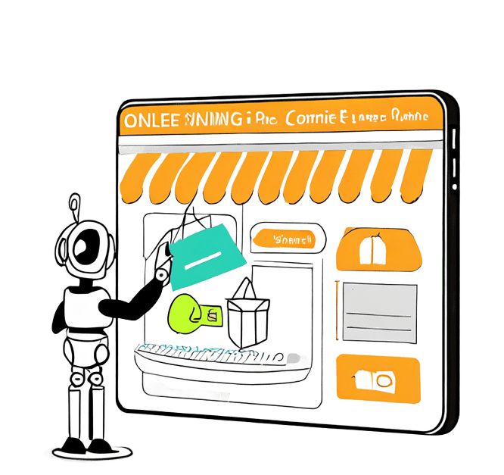

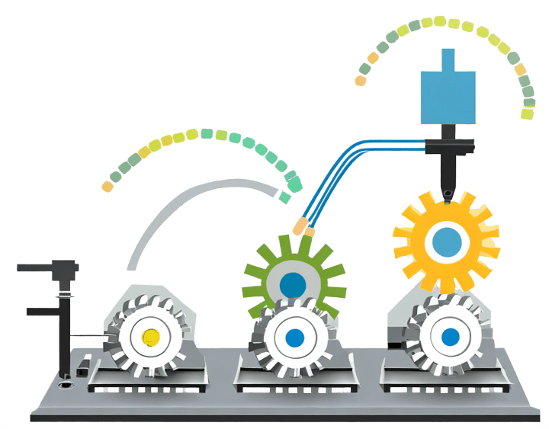
Events
System Under Test
Selenium
Error Report
Provengo
Notes:
Selenium is a library that facilitates automated engagements with web applications. Provengo incorporates a layer that transmits the events generated by our model to Selenium. This ensures that the scenarios created by our model are seamlessly converted into actions operating the system under test and validating its responses.

Slide 6
// @provengo summon selenium
const XPATHS = {
searchField: "//input[@name='q']",
submitButton: "//button[@type='submit']",
resultsSection: "//section[@data-test-id='mainline']",
body: "//body"
}
const seleniumSession = new SeleniumSession("user")
bthread("Search for pizza", function () {
with (seleniumSession) {
start("https://ecosia.org")
waitForVisibility(XPATHS.searchField, 10000)
writeText(XPATHS.searchField, "pizza")
click(XPATHS.submitButton)
waitForVisibility(XPATHS.resultsSection, 10000)
assertText(XPATHS.resultsSection, "pizza", [IgnoreCase, Contains])
waitForVisibility(XPATHS.body)
}
})
Notes:
This model, which we will now explain line by line, uses Selenium in Provengo to search for a pizza.

Slide 7
// @provengo summon selenium
const XPATHS = {
searchField: "//input[@name='q']",
submitButton: "//button[@type='submit']",
resultsSection: "//section[@data-test-id='mainline']",
body: "//body"
}
const seleniumSession = new SeleniumSession("user")
bthread("Search for pizza", function () {
with (seleniumSession) {
start("https://ecosia.org")
waitForVisibility(XPATHS.searchField, 10000)
writeText(XPATHS.searchField, "pizza")
click(XPATHS.submitButton)
waitForVisibility(XPATHS.resultsSection, 10000)
assertText(XPATHS.resultsSection, "pizza", [IgnoreCase, Contains])
waitForVisibility(XPATHS.body)
}
})
Notes:
The first line of the model summons the selenium library in Provengo.

Slide 8
// @provengo summon selenium
const XPATHS = {
searchField: "//input[@name='q']",
submitButton: "//button[@type='submit']",
resultsSection: "//section[@data-test-id='mainline']",
body: "//body"
}
const seleniumSession = new SeleniumSession("user")
bthread("Search for pizza", function () {
with (seleniumSession) {
start("https://ecosia.org")
waitForVisibility(XPATHS.searchField, 10000)
writeText(XPATHS.searchField, "pizza")
click(XPATHS.submitButton)
waitForVisibility(XPATHS.resultsSection, 10000)
assertText(XPATHS.resultsSection, "pizza", [IgnoreCase, Contains])
waitForVisibility(XPATHS.body)
}
})
Notes:
The second code snippet defines a collection of strings known as ‘xpaths’. These serve as standard identifiers for elements within a web page. We will delve deeper into the intricacies of these strings in upcoming presentations. For additional information, you can explore the topic on the internet by simply entering ‘xpath’ into a search engine.

Slide 9
// @provengo summon selenium
const XPATHS = {
searchField: "//input[@name='q']",
submitButton: "//button[@type='submit']",
resultsSection: "//section[@data-test-id='mainline']",
body: "//body"
}
const seleniumSession = new SeleniumSession("user")
bthread("Search for pizza", function () {
with (seleniumSession) {
start("https://ecosia.org")
waitForVisibility(XPATHS.searchField, 10000)
writeText(XPATHS.searchField, "pizza")
click(XPATHS.submitButton)
waitForVisibility(XPATHS.resultsSection, 10000)
assertText(XPATHS.resultsSection, "pizza", [IgnoreCase, Contains])
waitForVisibility(XPATHS.body)
}
})
Notes:
The third line involves the creation of an object of the SeleniumSession type. This object serves as the primary access-point for interaction with Selenium. An instance of the Selenium session type corresponds to a browser tab. In this demonstration, we confine our operations to a single tab, hence the definition of a single Selenium session. When conducting tests for concurrent site access, testers may employ multiple instances of the SeleniumSession class to orchestrate parallel actions across different tabs.

Slide 10
// @provengo summon selenium
const XPATHS = {
searchField: "//input[@name='q']",
submitButton: "//button[@type='submit']",
resultsSection: "//section[@data-test-id='mainline']",
body: "//body"
}
const seleniumSession = new SeleniumSession("user")
bthread("Search for pizza", function () {
with (seleniumSession) {
start("https://ecosia.org")
waitForVisibility(XPATHS.searchField, 10000)
writeText(XPATHS.searchField, "pizza")
click(XPATHS.submitButton)
waitForVisibility(XPATHS.resultsSection, 10000)
assertText(XPATHS.resultsSection, "pizza", [IgnoreCase, Contains])
waitForVisibility(XPATHS.body)
}
})
Notes:
We move to the fourth part of the code that specifies the events that we want to trigger using a bthread called “Search for Pizza”.

Slide 11
// @provengo summon selenium
const XPATHS = {
searchField: "//input[@name='q']",
submitButton: "//button[@type='submit']",
resultsSection: "//section[@data-test-id='mainline']",
body: "//body"
}
const seleniumSession = new SeleniumSession("user")
bthread("Search for pizza", function () {
seleniumSession.start("https://ecosia.org")
seleniumSession.waitForVisibility(XPATHS.searchField, 10000)
seleniumSession.writeText(XPATHS.searchField, "pizza")
seleniumSession.click(XPATHS.submitButton)
seleniumSession.waitForVisibility(XPATHS.resultsSection, 10000)
seleniumSession.waitForVisibility(XPATHS.body)
seleniumSession.assertText(XPATHS.resultsSection, "pizza", [IgnoreCase, Contains])
})
bthread("Search for pizza", function () {
with (seleniumSession) {
start("https://ecosia.org")
waitForVisibility(XPATHS.searchField, 10000)
writeText(XPATHS.searchField, "pizza")
click(XPATHS.submitButton)
waitForVisibility(XPATHS.resultsSection, 10000)
assertText(XPATHS.resultsSection, "pizza", [IgnoreCase, Contains])
waitForVisibility(XPATHS.body)
}
})
Notes:
The bthread employs the standard JavaScript ‘with’ construct, which offers a more streamlined method for accessing an object’s properties and methods. Within the ‘with’ block, functions such as ‘seleniumSession.start’ can be succinctly referred to as just ‘start’.

Slide 12
// @provengo summon selenium
const XPATHS = {
searchField: "//input[@name='q']",
submitButton: "//button[@type='submit']",
resultsSection: "//section[@data-test-id='mainline']",
body: "//body"
}
const seleniumSession = new SeleniumSession("user")
bthread("Search for pizza", function () {
seleniumSession.start("https://ecosia.org")
seleniumSession.waitForVisibility(XPATHS.searchField, 10000)
seleniumSession.writeText(XPATHS.searchField, "pizza")
seleniumSession.click(XPATHS.submitButton)
seleniumSession.waitForVisibility(XPATHS.resultsSection, 10000)
seleniumSession.waitForVisibility(XPATHS.body)
seleniumSession.assertText(XPATHS.resultsSection, "pizza", [IgnoreCase, Contains])
})
bthread("Search for pizza", function () {
with (seleniumSession) {
start("https://ecosia.org")
waitForVisibility(XPATHS.searchField, 10000)
writeText(XPATHS.searchField, "pizza")
click(XPATHS.submitButton)
waitForVisibility(XPATHS.resultsSection, 10000)
assertText(XPATHS.resultsSection, "pizza", [IgnoreCase, Contains])
waitForVisibility(XPATHS.body)
}
})
bthread("Search for pizza", function () {
sync({ request: StartSession(seleniumSession.name, "chrome", [URL]) });
sync({ request: WaitForVisibility(seleniumSession.name, [XPATHS.searchField], 10000) })
sync({ request: WriteText(seleniumSession.name, [XPATHS.searchField], "pizza", true) })
sync({ request: Click(seleniumSession.name, [XPATHS.submitButton]) })
sync({ request: WaitForVisibility(seleniumSession.name, [XPATHS.resultsSection], 10000) })
sync({ request: AssertText(seleniumSession.name, [XPATHS.resultsSection], "pizza", TextAssertions.toSet([IgnoreCase, Contains])) })
sync({ request: WaitForVisibility(seleniumSession.name, [XPATHS.body], 5000) })
})
Notes:
The functions of the SeleniumSession object are just wrappers to requesting events. So, this bthread simply requests a list of events in a sequence.

Slide 13
// @provengo summon selenium
const XPATHS = {
searchField: "//input[@name='q']",
submitButton: "//button[@type='submit']",
resultsSection: "//section[@data-test-id='mainline']",
body: "//body"
}
const seleniumSession = new SeleniumSession("user")
bthread("Search for pizza", function () {
seleniumSession.start("https://ecosia.org")
seleniumSession.waitForVisibility(XPATHS.searchField, 10000)
seleniumSession.writeText(XPATHS.searchField, "pizza")
seleniumSession.click(XPATHS.submitButton)
seleniumSession.waitForVisibility(XPATHS.resultsSection, 10000)
seleniumSession.waitForVisibility(XPATHS.body)
seleniumSession.assertText(XPATHS.resultsSection, "pizza", [IgnoreCase, Contains])
})
bthread("Search for pizza", function () {
with (seleniumSession) {
start("https://ecosia.org")
waitForVisibility(XPATHS.searchField, 10000)
writeText(XPATHS.searchField, "pizza")
click(XPATHS.submitButton)
waitForVisibility(XPATHS.resultsSection, 10000)
assertText(XPATHS.resultsSection, "pizza", [IgnoreCase, Contains])
waitForVisibility(XPATHS.body)
}
})
bthread("Search for pizza", function () {
sync({ request: StartSession(seleniumSession.name, "chrome", [URL]) });
sync({ request: WaitForVisibility(seleniumSession.name, [XPATHS.searchField], 10000) })
sync({ request: WriteText(seleniumSession.name, [XPATHS.searchField], "pizza", true) })
sync({ request: Click(seleniumSession.name, [XPATHS.submitButton]) })
sync({ request: WaitForVisibility(seleniumSession.name, [XPATHS.resultsSection], 10000) })
sync({ request: AssertText(seleniumSession.name, [XPATHS.resultsSection], "pizza", TextAssertions.toSet([IgnoreCase, Contains])) })
sync({ request: WaitForVisibility(seleniumSession.name, [XPATHS.body], 5000) })
})
Notes:
The functions of the SeleniumSession object are just wrappers to requesting events. So, this bthread simply requests a list of events in a sequence.

Slide 14
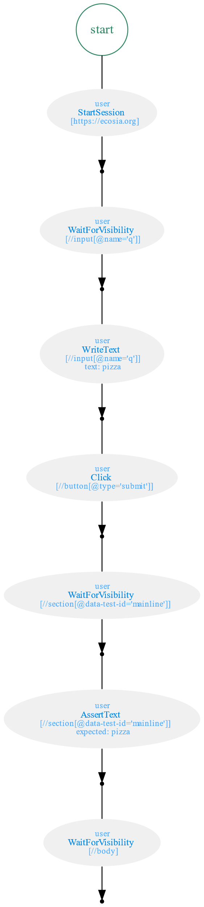
bthread("Search for pizza", function () {
sync({ request: StartSession(seleniumSession.name, "chrome", [URL]) });
sync({ request: WaitForVisibility(seleniumSession.name, [XPATHS.searchField], 10000) })
sync({ request: WriteText(seleniumSession.name, [XPATHS.searchField], "pizza", true) })
sync({ request: Click(seleniumSession.name, [XPATHS.submitButton]) })
sync({ request: WaitForVisibility(seleniumSession.name, [XPATHS.resultsSection], 10000) })
sync({ request: AssertText(seleniumSession.name, [XPATHS.resultsSection], "pizza", toSet([IgnoreCase, Contains]))})
sync({ request: WaitForVisibility(seleniumSession.name, [XPATHS.body], 5000) })
})
Notes:
Its state-space contains one sequence of events.

Slide 15

Notes:
When we execute the model, it triggers a series of events that, in turn, operate the site using Selenium.

Slide 16
bthread("Search for pizza", function () {
with (seleniumSession) {
start("https://ecosia.org")
waitForVisibility(XPATHS.searchField, 10000)
writeText(XPATHS.searchField, "pizza")
click(XPATHS.submitButton)
waitForVisibility(XPATHS.resultsSection, 10000)
assertText(XPATHS.resultsSection, "pizza", [IgnoreCase, Contains])
waitForVisibility(XPATHS.body)
}
})
Notes:
It’s important to note that our interaction with Selenium extends beyond merely instructing it to operate the site. We also utilize it to verify that the site responds as anticipated.

Slide 17
Events
System Under Test
Selenium
Error Report
Provengo
Notes:
In conclusion: we utilized a model to outline a test sequence, which was then executed using the Selenium library. This library offered us efficient methods for initiating event requests. Additionally, a background process was in place to observe the activation of these events, translating them into site interactions and validating the site’s responses.

Slide 18
Notes:
This brings our presentation to a close. We’ve seen how Selenium can be used within Provengo to test web sites.

